Slide 1


CLIMATE CHANGE BELIEVE ANALYSIS APPLICATION
BY
NEURAL DATA SOLUTIONS (NDS)
Notes:
Good day to all my fellow data enthusiasts and potential clients. I am ________ from Neural Data Solutions. We are honoured to day to be presenting at the 7th Edition of DataCon Africa our Climate change believe analysis application

Slide 2
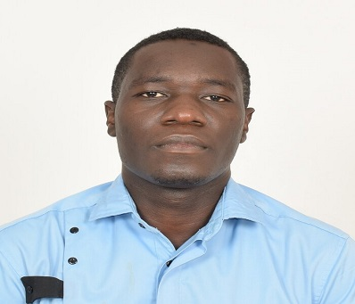

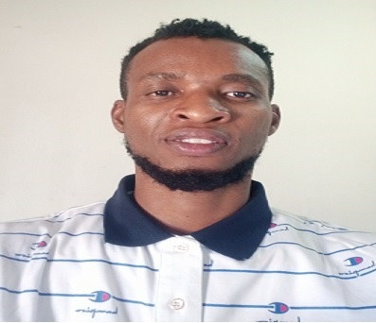



NDS TEAM
KEN
CEO
EMMANUEL
Machine Learning Engineer
SEYI
Lead Software Tester
BODINE
Project Manager
MOSES
Lead Software Developer
CLARA
Product Manager
Notes:
Today I am here with all my team members who worked so passionately and diligently on this project.

Slide 3
PRESENTATION OUTLINE
INTRODUCTION
SOLUTION
MODELLING
CONCLUSION AND RECOMMENDATIONS
1
3
5
7
2
4
6
PROBLEM STATEMENT
DATA INSIGHTS
APP DEMO
Notes:
A brief outline of our presentations is as follows…….Introduction…..

Slide 4
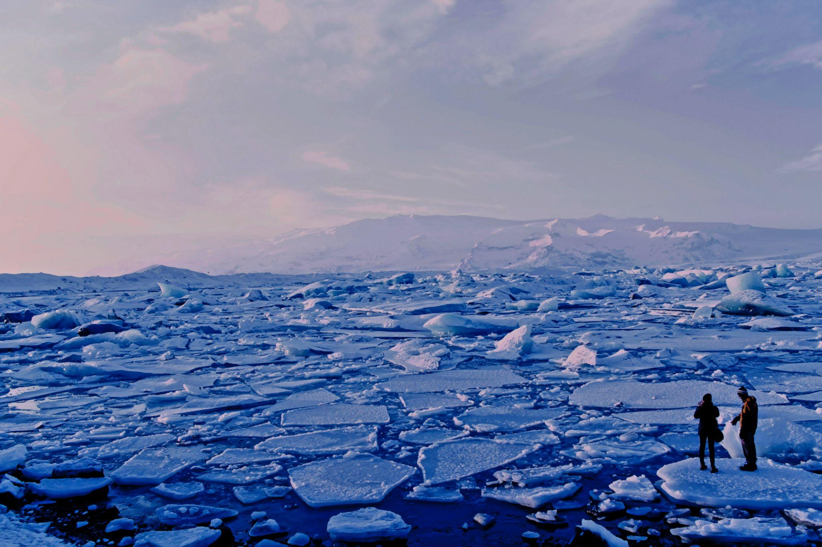
Photo by Roxanne Desgagnes on Unsplash,
Notes:
Climate change has become a buzzword in recent times. Climate change has done more harm than good. We have hotter temperatures, increased droughts, severe storms and even reduced agricultural productivity. This has led to loss of biodiversity, more health risk, decline in food supply, poverty and displacement.

Slide 5

PROBLEM STATEMENT
Sustainability
We at Neural Data Solutions (NDS), were tasked with creating an application that is able to classify whether or not a person believes in climate change, based on their novel tweet data.
Notes:
On this note, Many companies are committed to a sustainable future and to improving the social, economic and environmental well being of the community and are built around lessening one’s environmental impact or carbon footprint. They offer products and services that are environmentally friendly and sustainable, in line with their values and ideals. To assist these companies with their market research efforts in gauging how their product/service may be received. We at Neural Data Solutions (NDS), were tasked with creating an application that is able to classify whether or not a person believes in climate change, based on their novel tweet data.

Slide 6

SOLUTION
ECO
Noval twitter data
Future marketing strategies
Notes:
Eco was created to be an accurate and robust solution to this task by giving eco-friendly companies access to a broad base of consumer sentiment, spanning multiple demographic and geographic categories with the use of noval twitter data thereby forgoing lengthy surveys. This in turn increases the companies insights and informing future marketing strategies.

Slide 7
DATASET OVERVIEW
1
What is our data telling us?

Slide 8
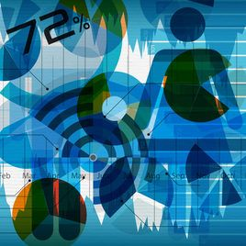
Turning complex data sets into beautiful, simple diagrams that tease out unseen patterns and connections. Is the best way to navigate information glut -- and it may just change the way we see the world.
“David McCandless”

Slide 9
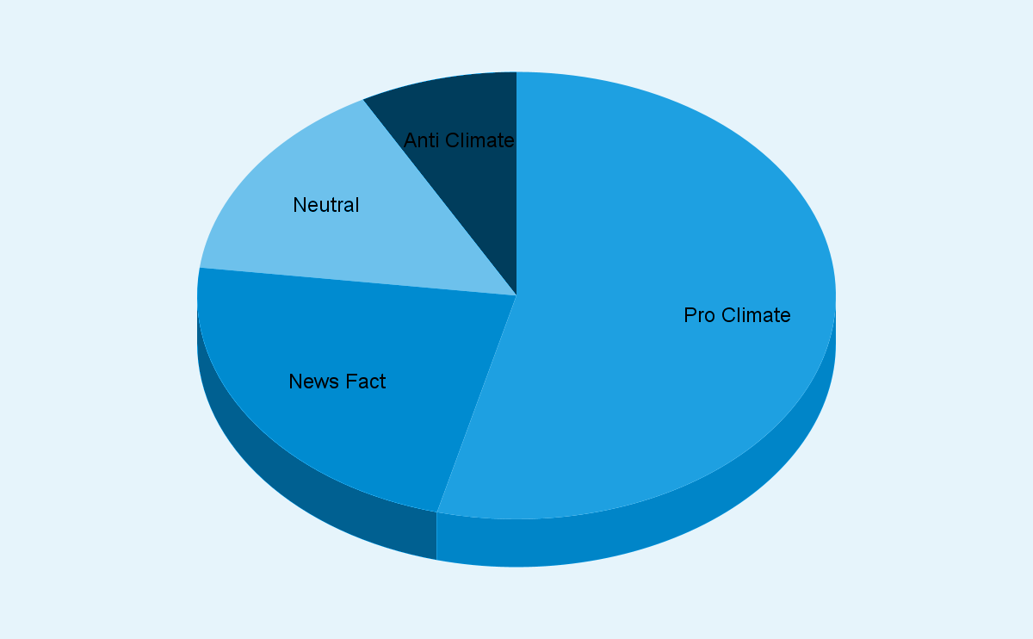
SENTIMENT ANALYSIS

Slide 10
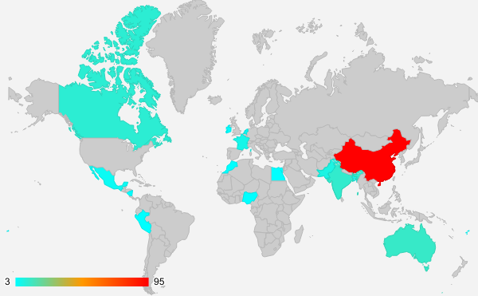
COUNTRY’S PRESENCE
This shows the most talked about countries in “CLimate Change” discussion or tweets
canada
france
morocco
china
egypt
mexico
india
nigeria
china
australia

Slide 11
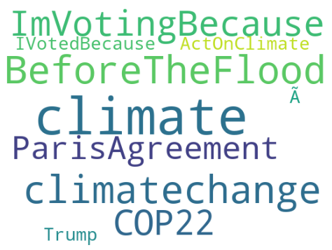
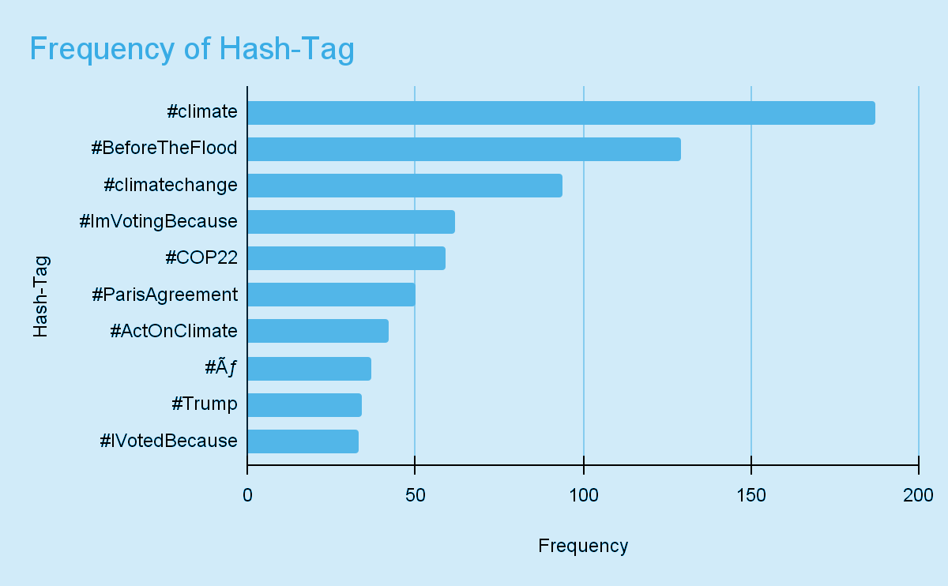
MOST- FREQUENT HASHTAGS
Popular Hashtags associated with Believers of Man-made Climate change

Slide 12
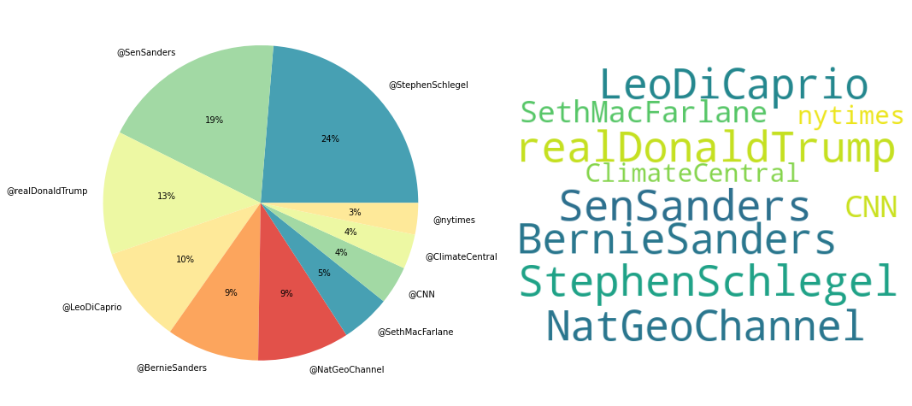
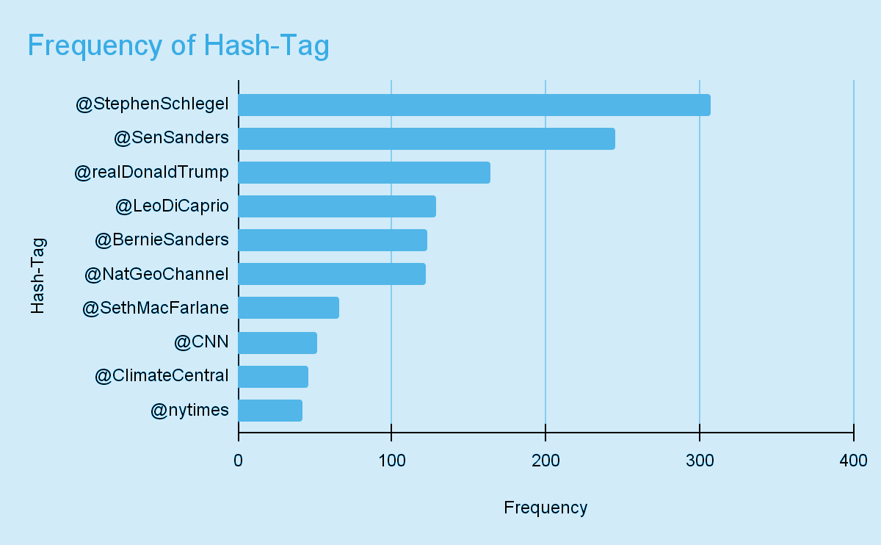
MOST- FREQUENT MENTIONS
Popular Mentions associated with Believers of Climate change

Slide 13
MACHINE LEARNING PROCESS
Stage 1
Stage 2
Stage 3
Stage 4
Data Pre-processing
Features Engineering
Modeling
Model Performance
We clean the dataset, transform and look at insight the data offers
Selecting suitable predictor(s), engineering new features and preparing them for machine learning process
Understanding data entries pattern and using that to forecast future target variables
Selecting the best or most suitable model using various metrics to understand each model performance

Slide 14
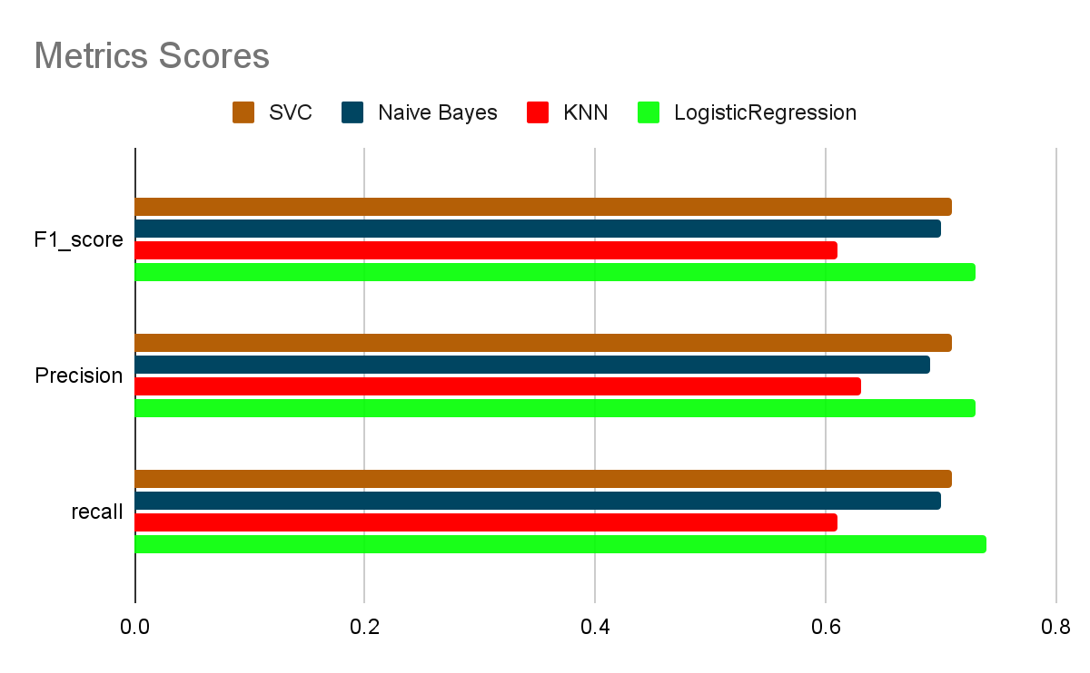
4000
3000
2000
1000
0
All the Classification metrics point to Logistic Regression as the better Model

Slide 15
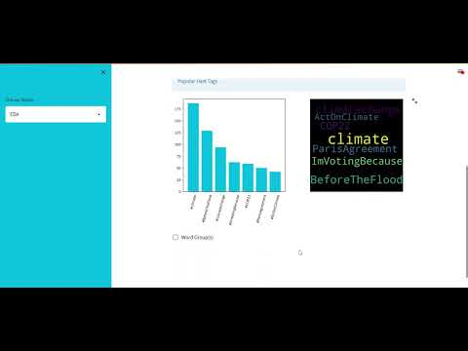
APP DEMONNSTRATION

Slide 16
UNIQUE VALUE PROPOSITION
Robust Data insight
Analysis of group of tweets
User Friendly
Scalable

Slide 17
RECOMMENDATIONS
Awareness
Identify group of customers that are not so enthusiastic about your product and inform strategies for building awareness
Marketing
Companies can apply popular pro-climate change mentions and hashtags to identify top influencers for your brand.
Engagement
Increase engagement with brand and its product among broad base of customers especially top users.

Slide 18
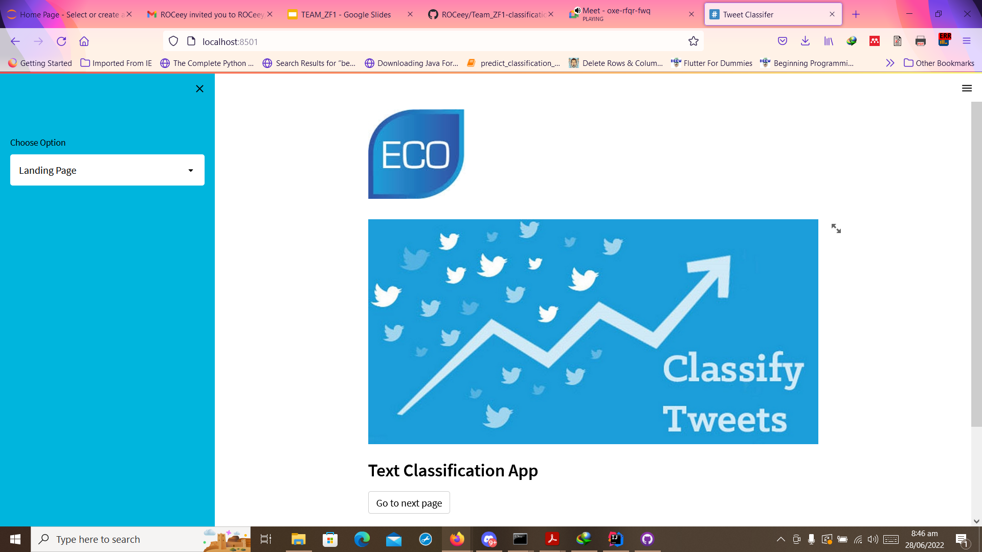
CONCLUSION
Based on the insights from the data:
It is clear that there are many people who believe and can equally tilt towards eco-friendly products and brands
America and China seem to be more involved as a whole.
The solution we provide can give insight and predict the sentiment based on novel tweets
Screenshot of the app will go here

Slide 19
THANKS!
Any questions?

